Slide 1
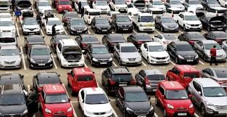
Used Cars Price Prediction
PAULAMI SANYAL
June 2022

Slide 2
OBJECTIVE
The main objective of this analysis focuses on the prediction of price of used cars.
Running to used car dealers just to get the optimal price of that old car sellers need to gather might be an unnecessary trouble.
Our objective is to build a model that could predict the optimal price that they might receive while selling their old cars.

Slide 3
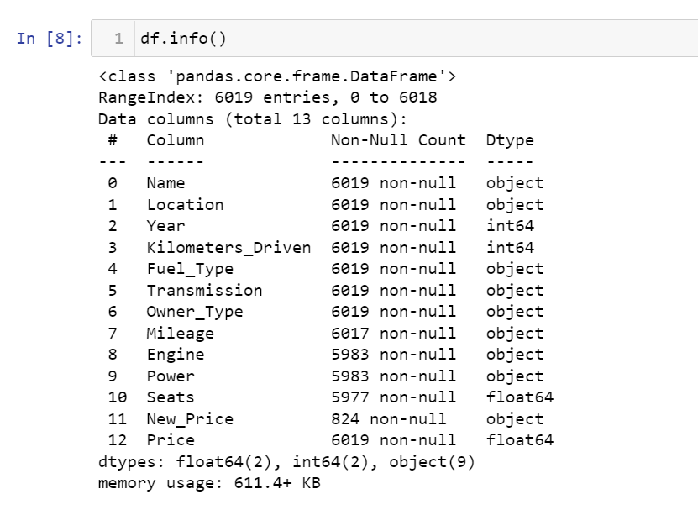
Description of the Data
The dataset consists of 13 columns: 12 features and one target ‘Price’.

Slide 4
Summary of dataset
The features of the dataset are:
Name – Model of the car
Location – City where the car is sold
Year – Year of Manufacture
Kilometers_Driven – Number of Kilometres the car has been driven
Fuel_Type – The type of fuel the car runs on
Transmission
Owner_Type – Whether the car has been sold first, second, third, fourth or more number of times before
Mileage – How many kilometres do the car run per litre of fuel
Engine – The capacity of the engine in CC (cubic centimetres)
Power – The power of the engine
Seats – Number of seats in the car
New_Price – Price of a new car
Price – Current price of the car. This is our target variable.

Slide 5
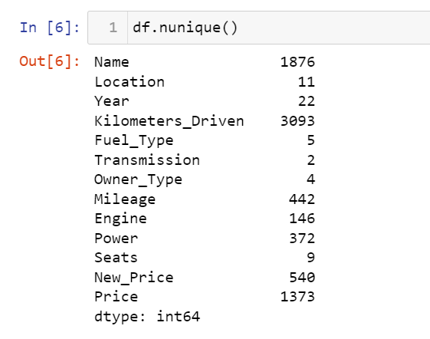
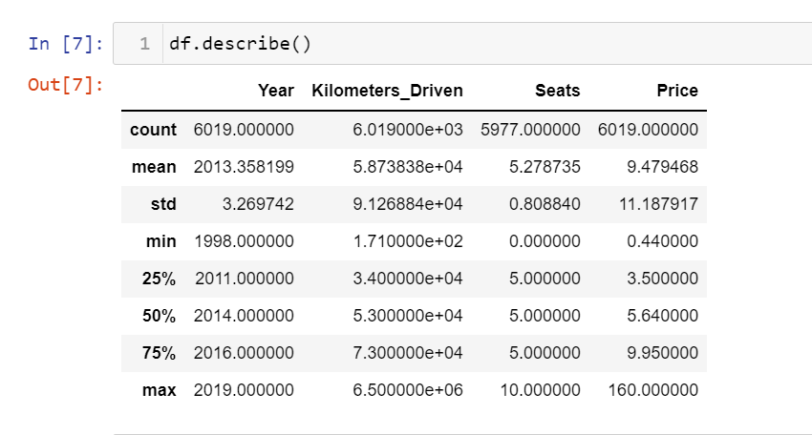
Data exploration
There are 6019 data points and 12 features with 4 numeric and 9 object data types.

Slide 6
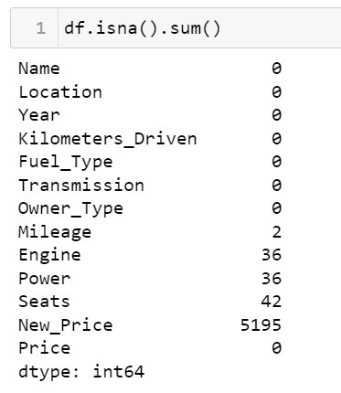
Data cleaning
There are 5195 null values for the feature New_Price our of 6019 datapoints. So, we remove this feature entirely.
We also remove all the null valued rows from the features Mileage, Engine, Power, & Seats

Slide 7
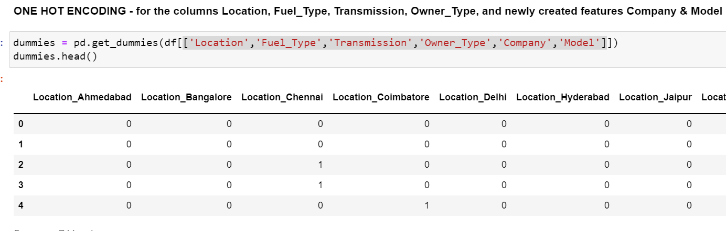
Feature engineering
We derived the name of the company & the model of the car, while removing the name column
As object datatypes cannot be used in the modelling we converted them to numeric values using one-hot-encoding – for columns location, fuel_type, transmission, owner_type, company & model

Slide 8
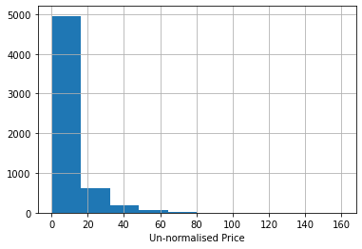
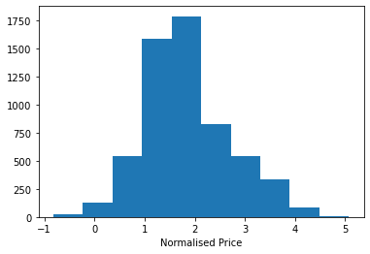
Feature engineering
Our target variable price was right-skewed. We used log-transformation to normalize it. This improved both the error values and r-square values and gave us an improved model.

Slide 9
Summary of linear regression models
Simple linear regression – Simple linear regression model had a R-square value of about 81%
Linear regression with polynomial effects – my system had memory restrictions hence I had to build this one with polynomial of degree one, which is same as simple linear regression and had a r-square value of 81% as well
Regularization regression – we applied ridge, lasso & elastic net regularization techniques for model building and found that elastic net regression had the least root mean square error and the highest r-square value of all three.

Slide 10
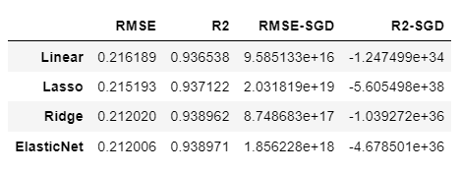
Model recommendation
In terms of both root mean square error and r-square value, we find that regression with elastic net regularization to be the best alternative amongst simple linear regression, ridge regression, lasso regression and elastic net regression.
Even in stochastic gradient descent, elastic net had better values than the rest of the models.

Slide 11
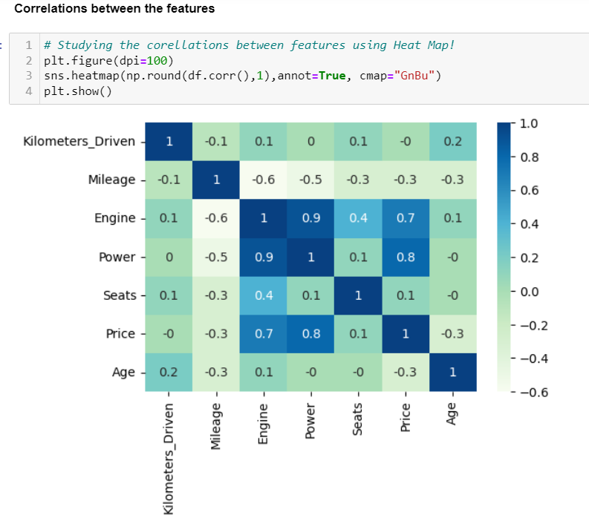
Key findings & insights
From the heatmap created we find that the features Power & Engine most positively correlated, followed by Power & Price, and Engine & Price.
So, we can say that Power & Engine are the most important features that decides the valuation of the car.

Slide 12
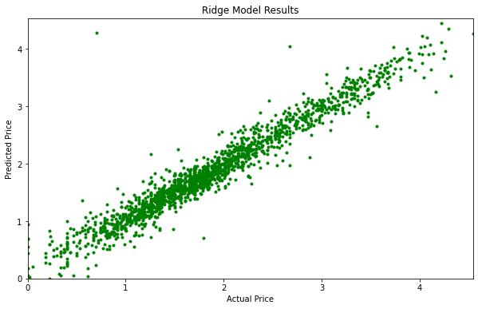
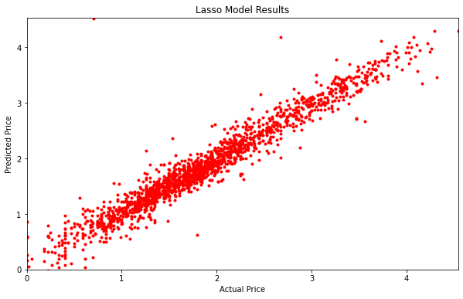
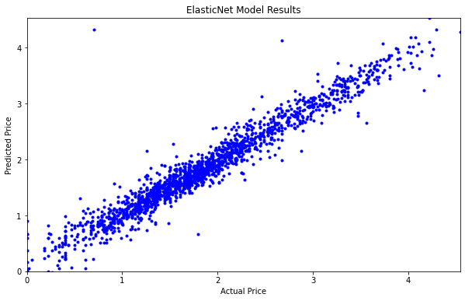
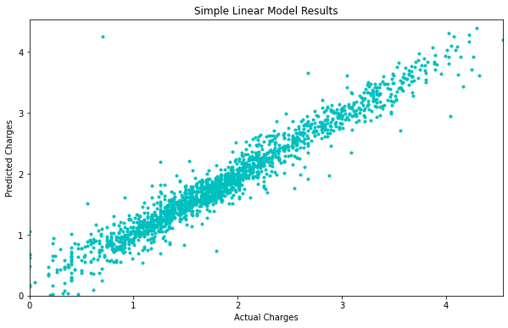
Key findings & insights

Slide 13
Key findings & insights
Normalizing the target variable price made the evaluation linearly distributed through all the models – linear regression, ridge regression, lasso regression and elastic net regression.
However, elastic net had the best values of all of them, and hence is recommended.

Slide 14
Suggestions for next steps
Linear regression ran very smoothly and very fast. However, the regularization took much more time for training the models, but provided better outcomes in terms of error and r-square values.
Personally, I would’ve added a feature of how many times the car was taken for servicing since being sold the first time. This feature might improve the model building as well as evaluation to some extent. This feature might be added to the model and evaluated further.

Slide 15
references
kaggle.com
Github.com

Slide 16
Thank you!
IBM Machine Learning Professional Certificate
Supervised Machine Learning: Regression
By PAULAMI SANYAL

